Slide 1
Breast Cancer Predictor

Slide 2
TEAM INTRODUCTION
ADITYA KUMAR(TEAM LEADER) (Group no. 9)
2820190
SURUCHI(TEAM MEMBER)
2820119
RHYTHM(TEAM MEMBER)
2820164

Slide 3
PROBLEM STATEMENT
The aim of this project is to develop a robust and accurate machine learning model for the early detection and prediction of breast cancer. Despite advancements in medical technology, early diagnosis remains a critical factor in improving treatment outcomes. This project seeks to address the need for an efficient and reliable system that leverages machine learning algorithms to analyze diverse datasets, including patient demographics, medical history, and imaging data. The primary challenge is to design and implement a predictive model that can classify breast cancer cases with high precision, sensitivity, and specificity, thereby contributing to timely and effective medical interventions.

Slide 4
BREAST CANCER
Breast cancer is cancer that develops from breast tissue. Signs of breast cancer may include a lump in the breast, a change in breast shape, dimpling of the skin, fluid coming from the nipple, a newly inverted nipple, or a red or scaly patch of skin. In those with distant spread of the disease, there may be bone pain, swollen lymph nodes, shortness of breath, or yellow skin.Risk factors for developing breast cancer include being female, obesity, a lack of physical exercise, alcoholism, hormone replacement therapy during menopause, ionizing radiation, an early age at first menstruation, having children late in life or not at all, older age, having a prior history of breast cancer, and a family history of breast cancer. About 5–10% of cases are the result of a genetic predisposition inherited from a person’s parents, including BRCA1 and BRCA2 among others.

Slide 5
BREAST CANCER PREDICTOR SYSTEM
A breast cancer prediction system harnesses the power of machine learning algorithms to meticulously scrutinize datasets comprising diverse tumor attributes, encompassing size, shape, texture, and other pertinent characteristics extracted from medical imaging or clinical records. Through the analysis of this historical data, the system endeavors to construct a robust predictive model. This model is designed to discriminate between malignant (cancerous) and benign (non-cancerous) tumors with a high degree of accuracy.By utilizing this system, healthcare professionals can leverage advanced technology to support their diagnostic processes. The system assists in the early detection of potential malignancies and provides insights into the likelihood of tumor malignancy based on its features. This aids medical practitioners in making more informed decisions regarding patient care, including treatment planning and strategies. The ultimate goal of such a system is to contribute to improved patient outcomes by facilitating earlier diagnoses, enabling prompt interventions, and potentially enhancing the effectiveness of treatment protocols tailored to individual patient needs. The amalgamation of data-driven insights and medical expertise can potentially revolutionize breast cancer diagnosis and care, offering a promising avenue for more proactive and precise healthcare interventions.

Slide 6
TECHNOLOGY STACK
Python
Juypter notebook
Machine learning

Slide 7
RANDOM FOREST ALGORITHM
The Random Forest algorithm is a popular ensemble learning method in machine learning. It constructs multiple decision trees during training and merges them together to create a more robust and accurate model. Each tree in the forest is trained on a random subset of the data and uses a random subset of features, which helps to reduce overfitting and improves generalization. This algorithm operates by generating a multitude of decision trees and combines their outputs through a voting process (classification) or averaging (regression) to make predictions. Each tree independently learns from a random subset of the data and contributes to the final prediction. Random Forests are versatile, effective for classification and regression tasks, and are known for handling large datasets with high dimensionality while providing good accuracy and resilience against overfitting.

Slide 8
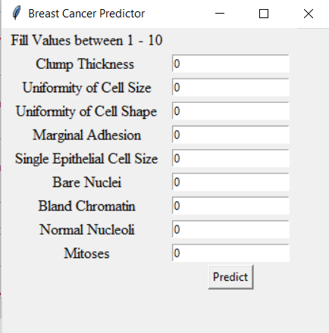
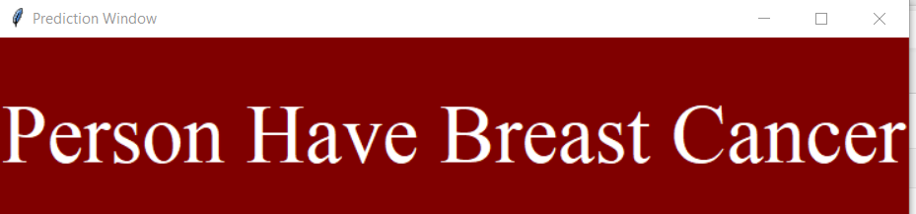
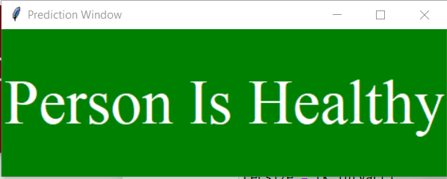
PROJECT USER INTERFACE

Slide 9
CONCLUSION
We can notice that SVM takes about 0.07 s to build its model unlike k-NN that takes just 0.01 s. It can be explained by the fact that k-NN is a lazy learner and does not do much during training process unlike others classifiers that build the models. In other hand, the accuracy obtained by SVM (97.13%) is better than the accuracy obtained by C4.5, Naïve Bayes and k-NN that have an accuracy that varies between 95.12 % and 95.28 %. It can also be easily seen that SVM has the highest value of correctly classified instances and the lower value of incorrectly classified instances than the other classifiers After creating the predicted model, we can now analyse results obtained in evaluating efficiency of our algorithms. SVM and C4.5 got the highest value (97 %) of TP for benign class but k-NN correctly predicts 97% of instance that belong to malignant class. The FP rate is lower when using SVM classifiers (0.03 for benign class and 0.02 for malignant class), and then other algorithms follow: k-NN, C4.5 and NB. From these results, we can understand why SVM has outperformed other classifiers. In summary, SVM was able to show its power in terms of effectiveness and efficiency based on accuracy and recall.

Slide 10
THANK YOU

